Slide 1
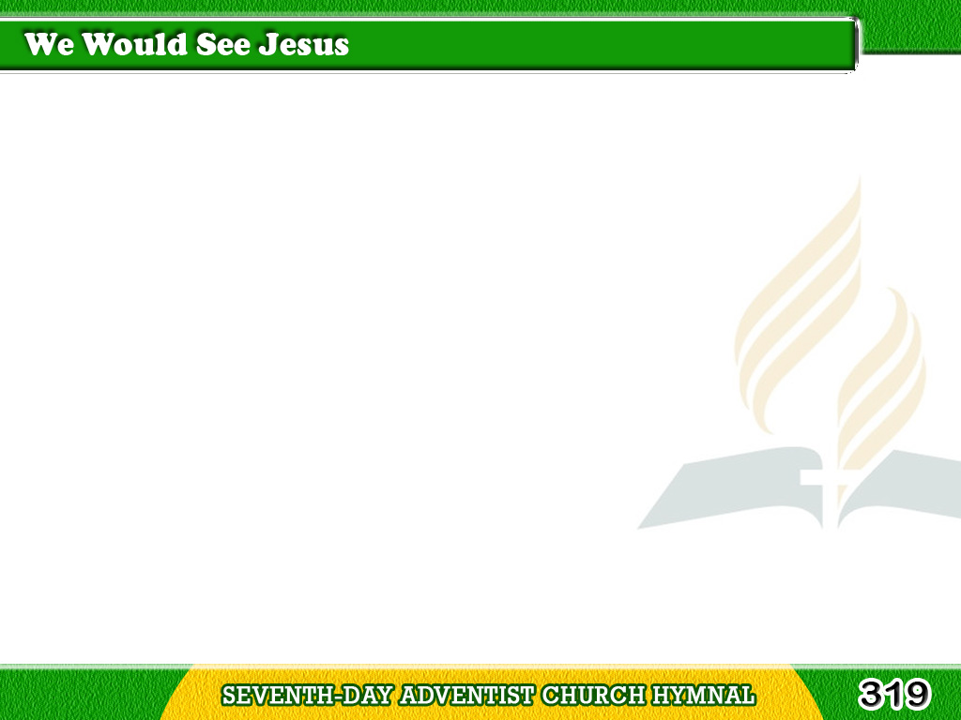
1/4
“We would see Jesus;”
for the shadows lengthen
Across the little
landscape of our life;
Tagalog
Version

Slide 2
1/4
We would see Jesus,
our weak faith to strengthen
For the last conflict,
in this mortal strife.
Tagalog
Version

Slide 3
2/4
“We would see Jesus,”
Rock of our salvation,
Whereon our feet were
set with sovereign grace;
Tagalog
Version

Slide 4
2/4
Not life, nor death,
with all their agitation,
Can thence remove us,
gazing on His face.
Tagalog
Version

Slide 5
3/4
“We would see Jesus;”
other lights are paling,
Which for long years
we did rejoice to see;
Tagalog
Version

Slide 6
3/4
The blessings of this
sinful world are failing;
We would not mourn them,
in exchange for Thee.
Tagalog
Version

Slide 7
4/4
“We would see Jesus;”
this is all we’re needing
Strength, joy, and willingness
come with the sight;
Tagalog
Version

Slide 8
4/4
We would see Jesus,
dying, risen, pleading,
Soon to return and
end this mortal night!
Tagalog
Version

